Slide 1
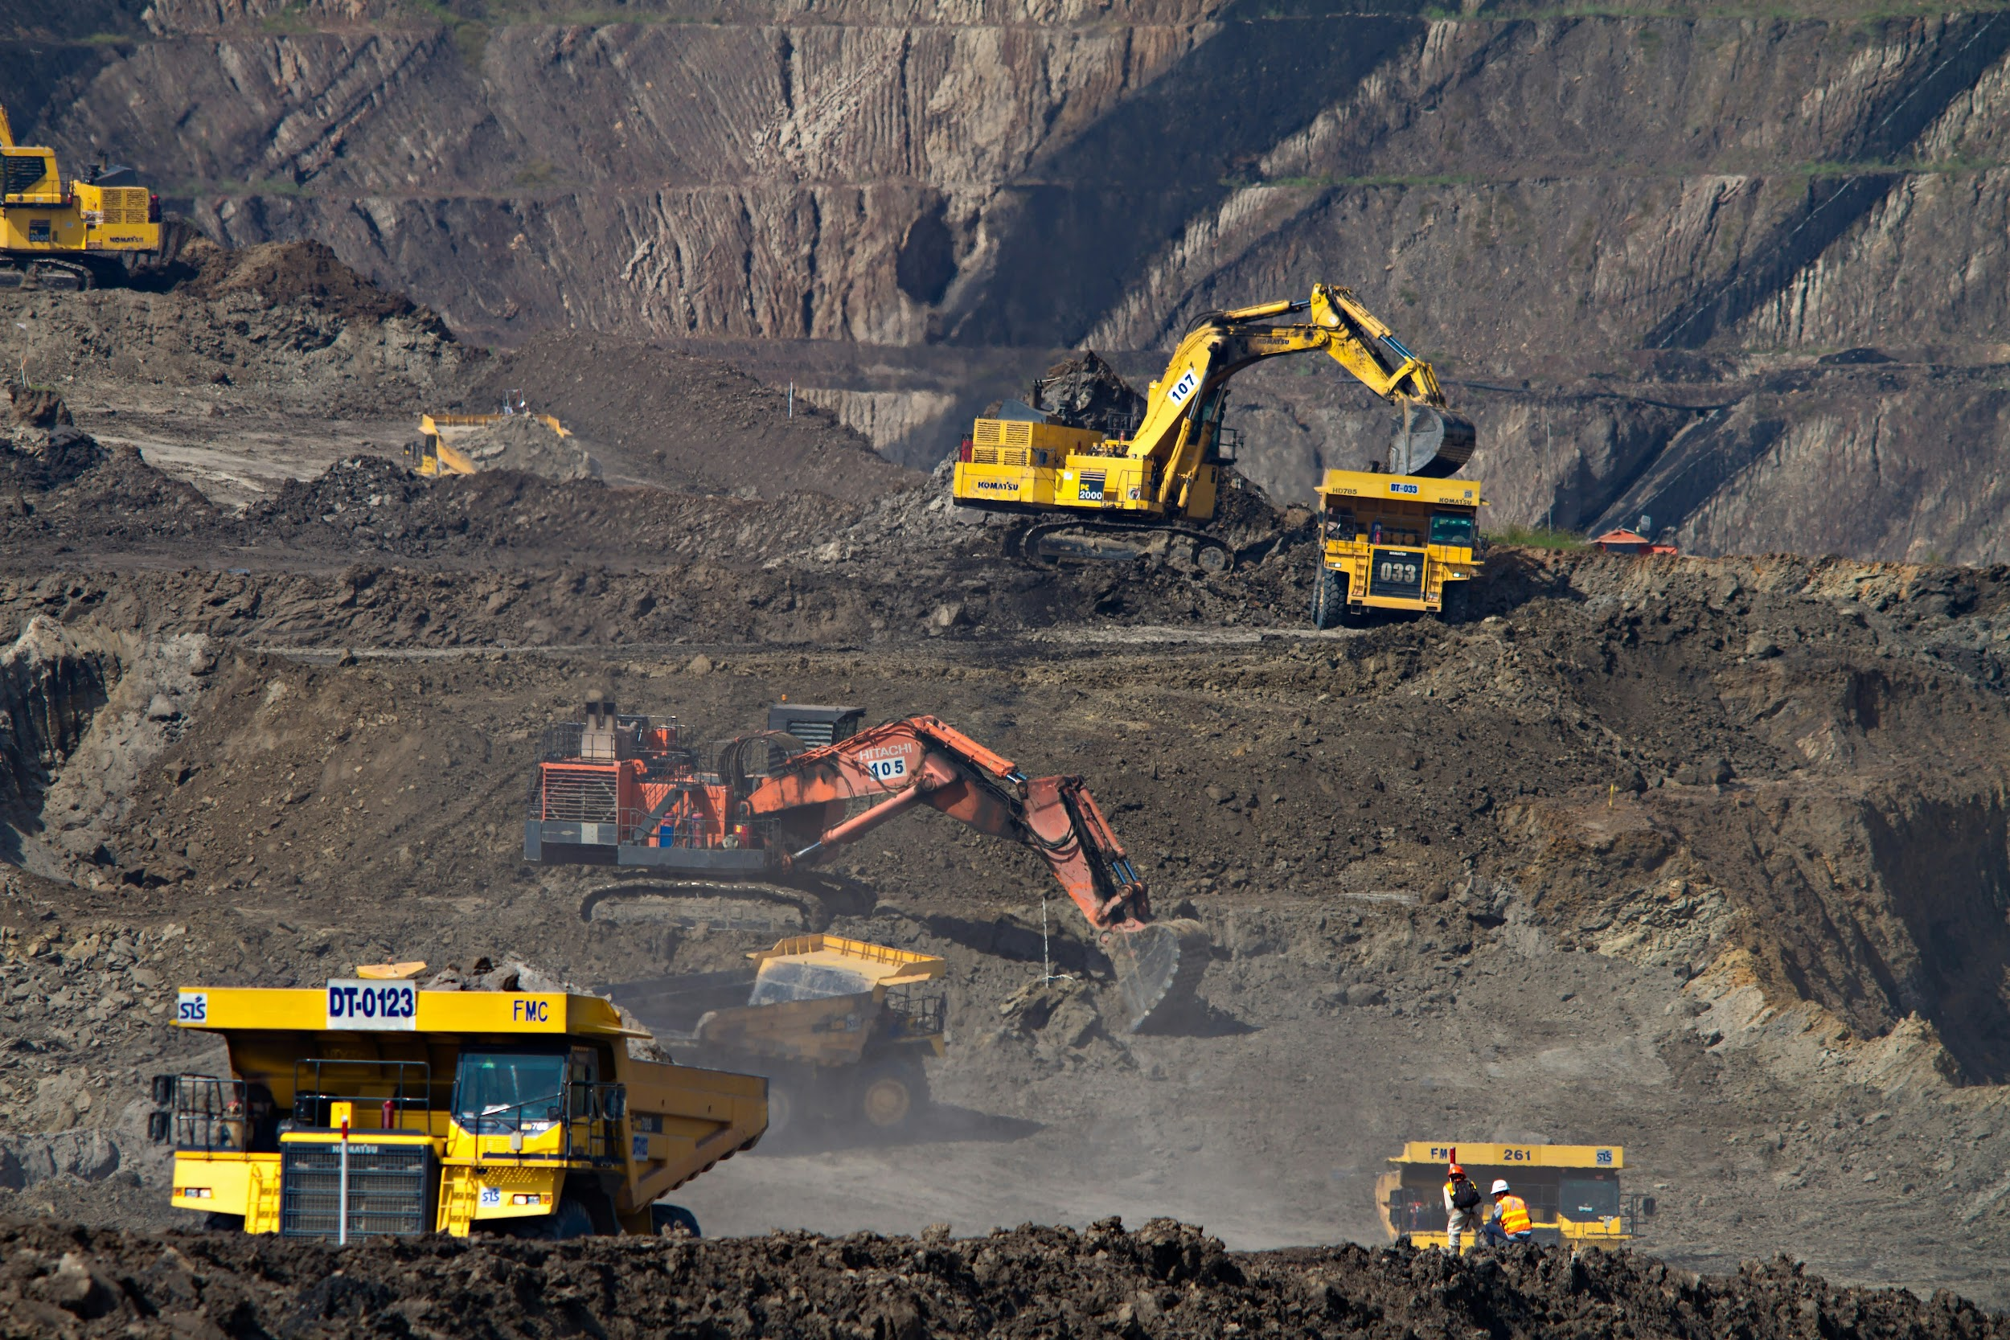
Dump-truck (DT) problem

Slide 2
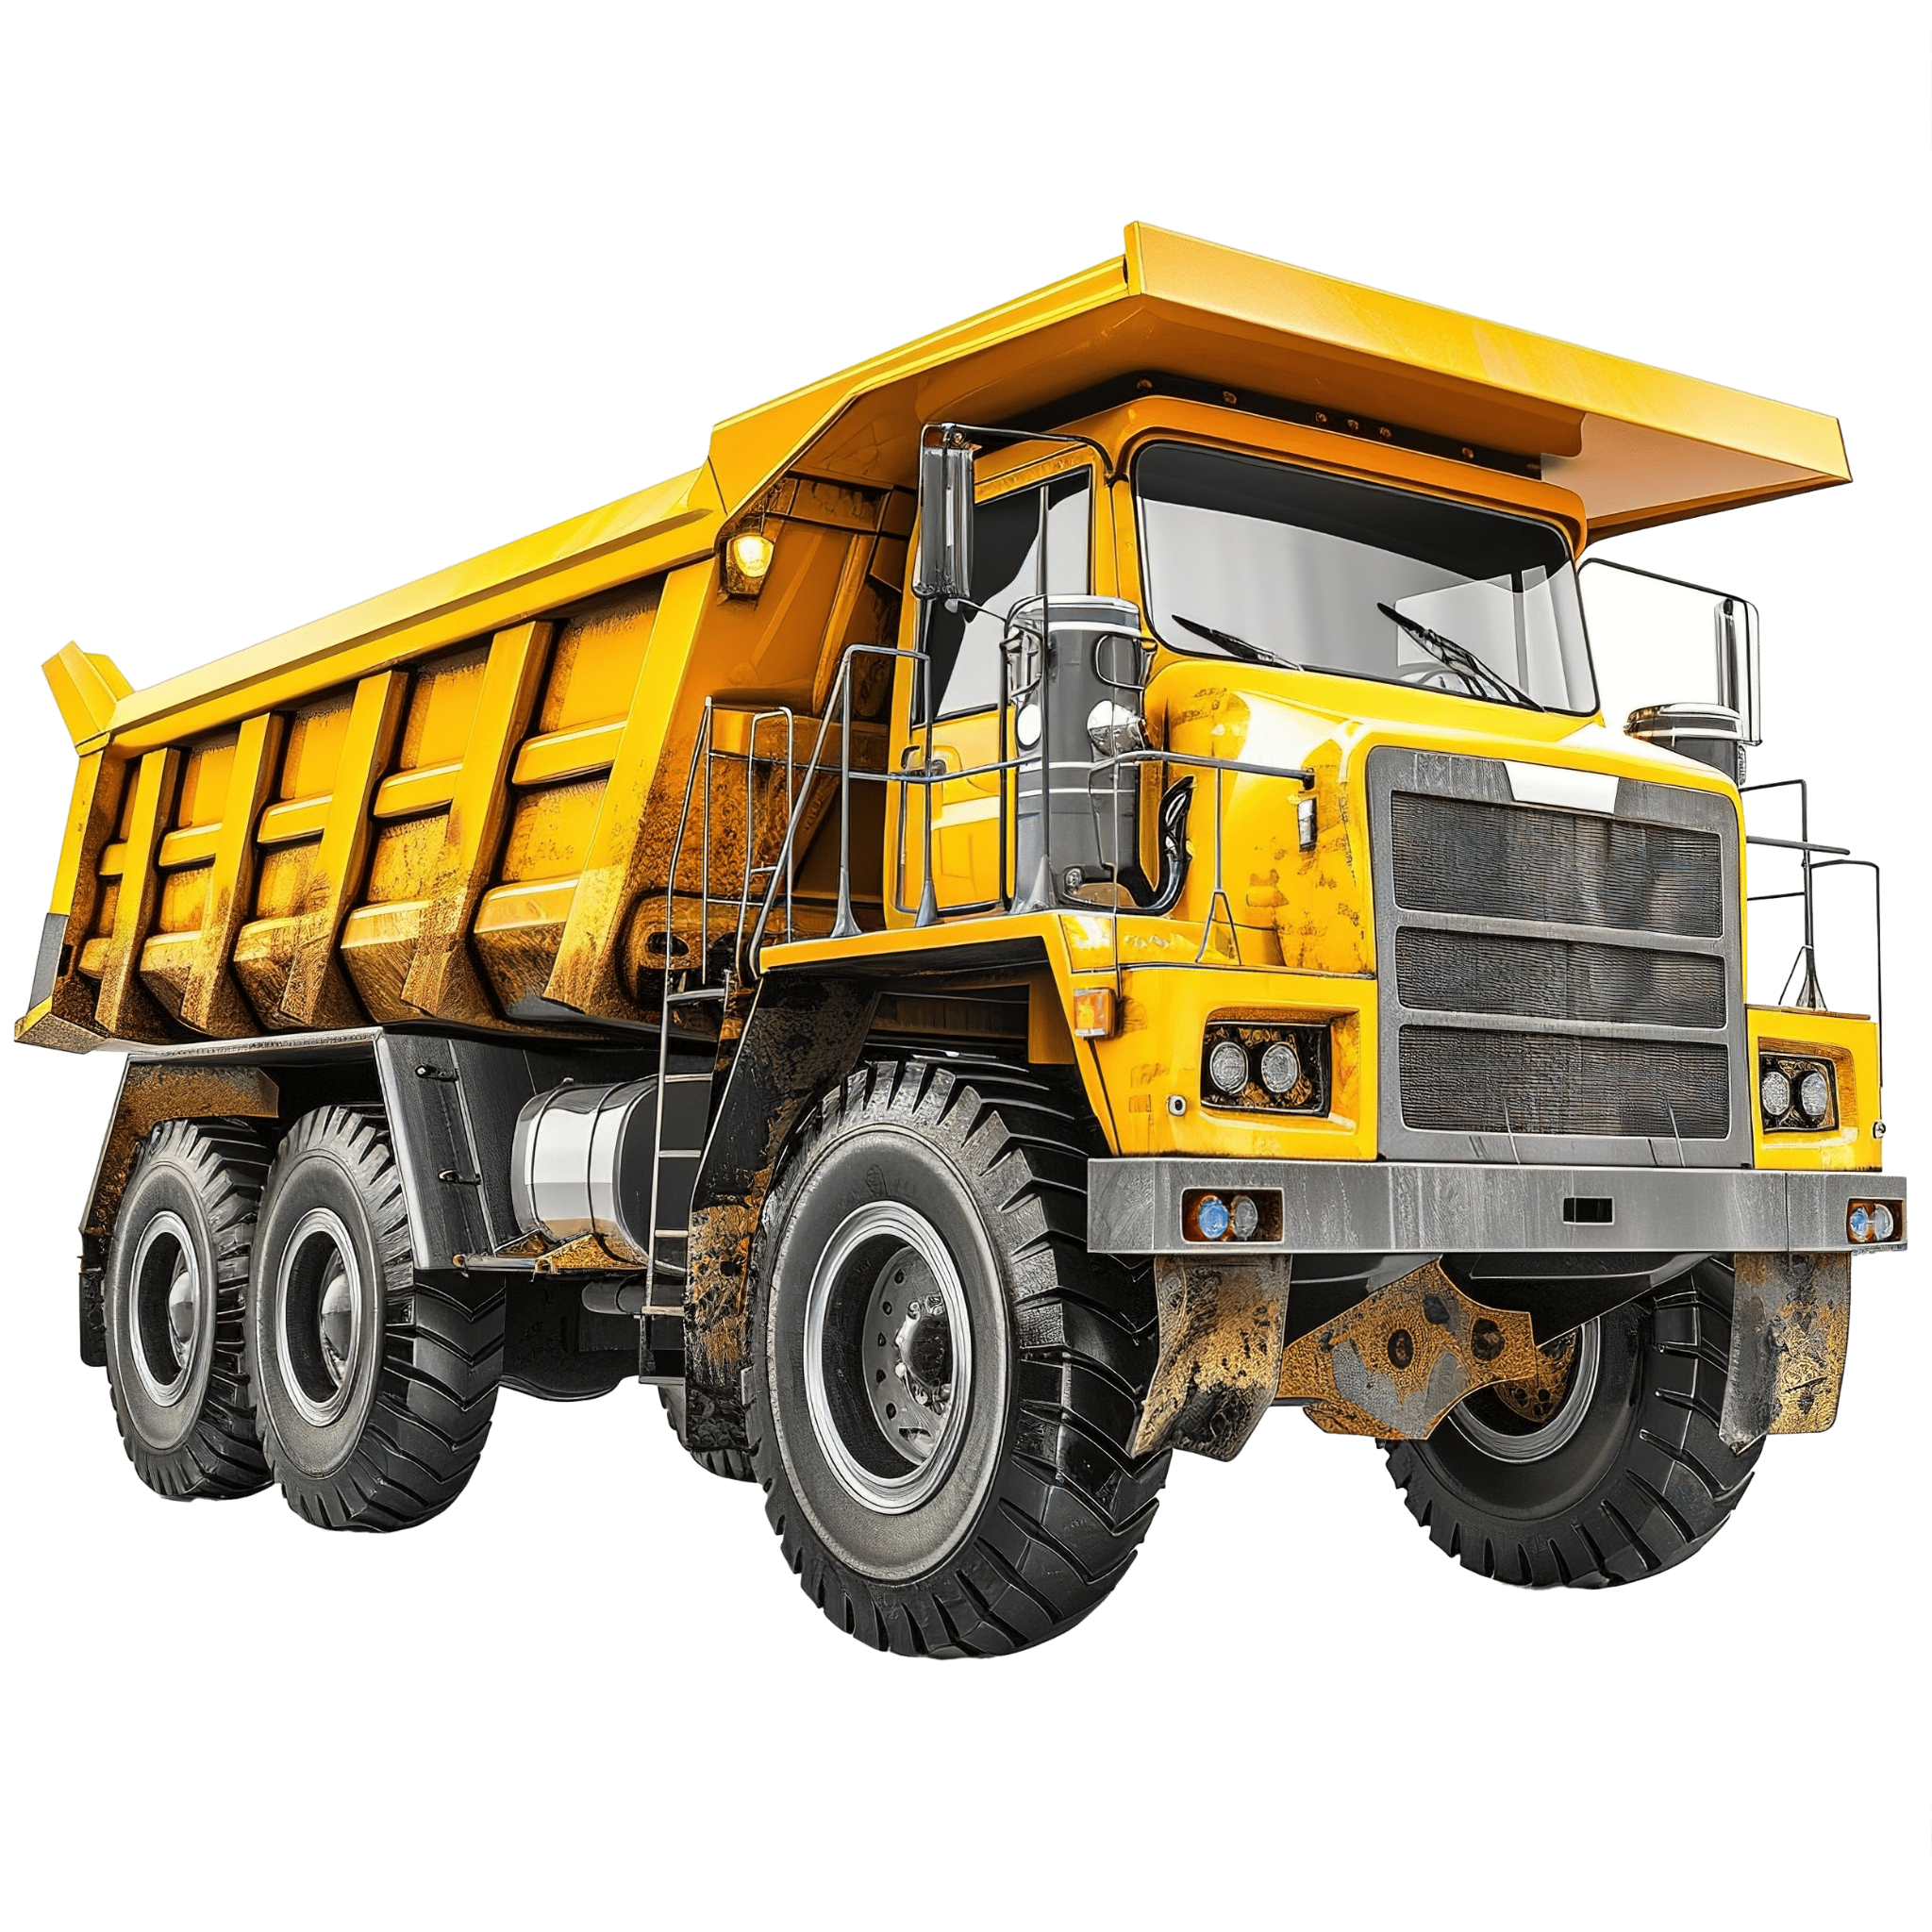
What happens?
Travel Time
We have six dump trucks, two loaders, and a scale.
Each truck is loaded by one of the two loaders and then moves to the scale to be weighed.
Both the loaders and the scale have first-come–first-served waiting lines for trucks.
Que
Loader
Scale
Loader
Weighing que

Slide 3
Terms
LQ(t) = number of trucks in the loading que
L(t) = number of trucks being loaded - 0, 1 or 2
WQ(t) = number of trucks in the weighing que
W(t) = number of trucks being weighed - 0 or

Slide 4
Performance Metrics
BL = total busy time of both loaders from time 0 to time t
BS = total busy time of the scale from time 0 to time t

Slide 5
Event Noticies
(ALQ, t, DTi), truck DTi arrives at loader queue (ALQ) at time t;
(EL, t, DTi), DTi ends loading (EL) at time t;
(EW, t, DTi), DTi ends weighing (EW ) at time t.

Slide 6
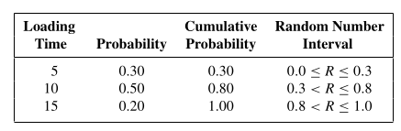
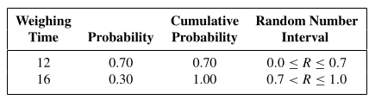
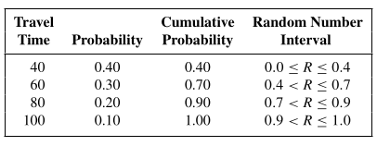
Distributions
Loading time for dump trucks
Weighing time for the dump trucks
Travel time for dump trucks

Slide 7
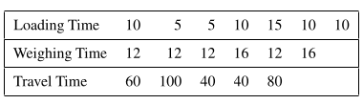
Randomly Generaged Activity Times

Slide 8
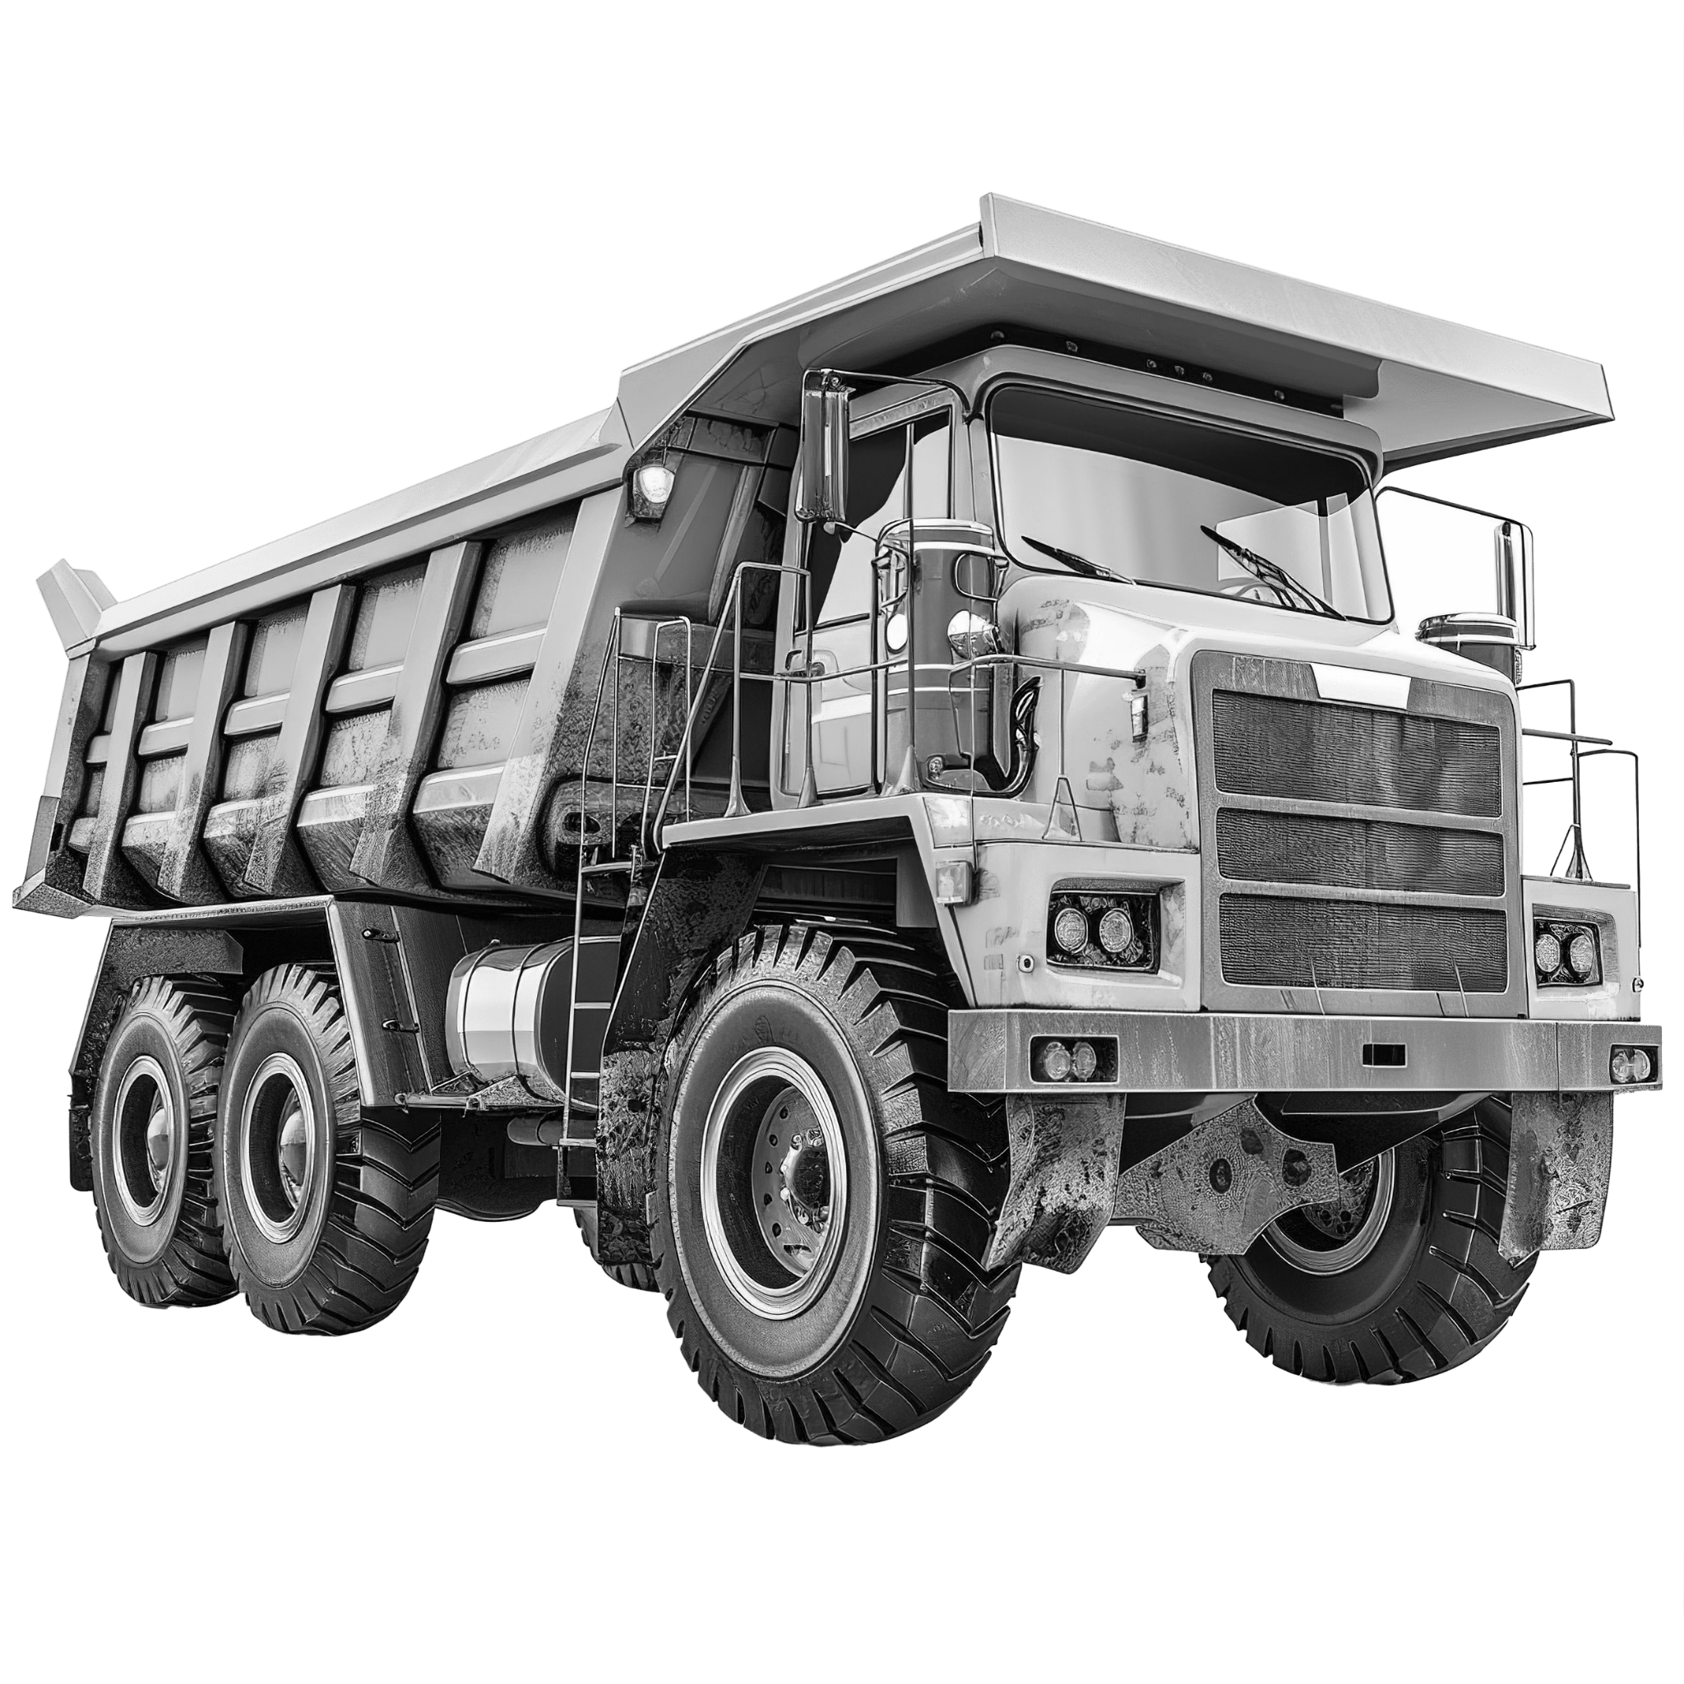
L(t)
LQ(t)
WQ(t)
W(t)
Time 0

Slide 9
SIMULATION TABLE..
CLOCK | LQ(t) | L(t) | WQ(t) | W(t) | Loader Que | Weigh Que | FEL | Bl | Bs
0 | 3 | 2 | 0 | 1 | Phiri, Zaid, Sogolera | - | (EL, 5, Maulana) (EL, 10, Soko) (EW, 12, Baki) | 0 | 0
5 | 2 | 2 | 1 | 1 | Zaid, Sogolera | Maulana | (EL, 10, Phiri) EL, 10, Soko) (EW, 12, Baki) | 5 | 5
.
.
.
Notes:
Baki being weighed, Maulana + Soko

